Slide 1


Airbnb Price Prediction and Business Insights Through R and Machine Learning
CIS 5550 – DATA MINING FOR BUSINESS ANALYTICS
Instructor – Dr. Lusi Li
Presented By:
Ayushi Porwal
Zalak Patel
Sapan Shah
Snehil Sarkar

Slide 2
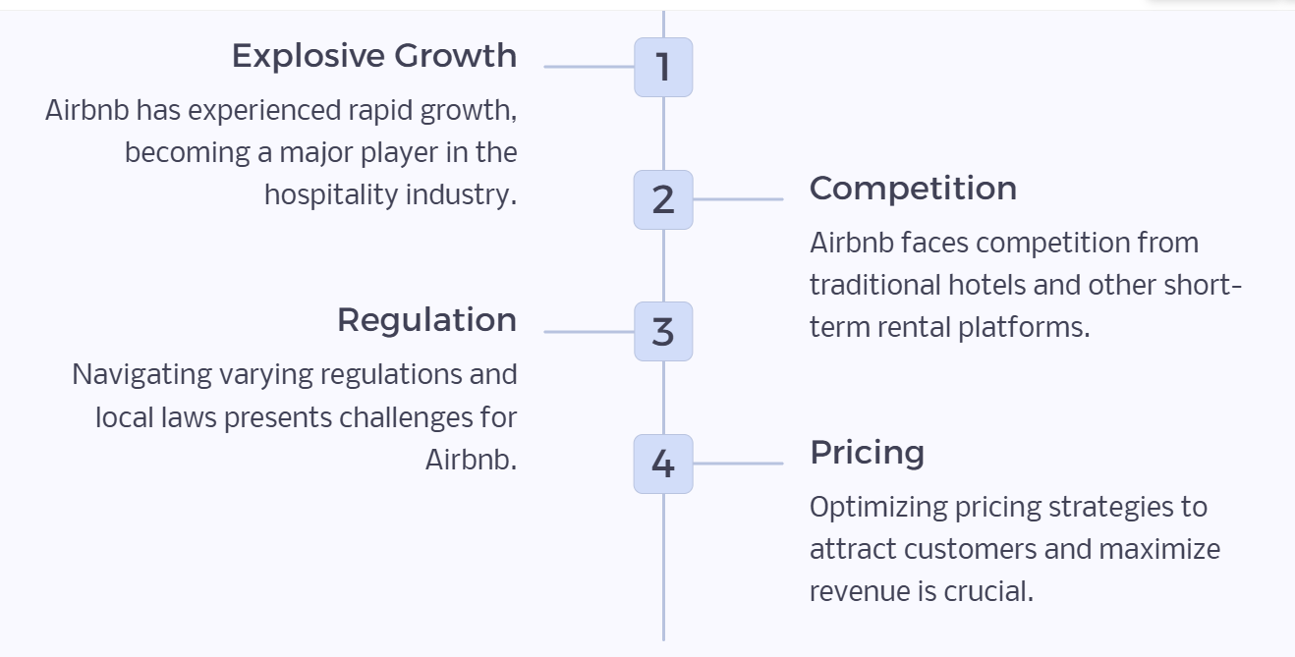
Introduction to Airbnb: Rapid Growth and Emerging Challenges
Why is LA so significant?
Tourism Appeal
Higher Rental Rates
Year-Round Demand
Dataset Overview
Unit of Analysis
Listing
Host
Pricing
Reviews
Neighborhood

Slide 3

Platform and Data Cleaning
03.
01.
Platform:
Analysis performed in RStudio.
Data Cleaning Steps:
Column Renaming: Standardized column names for consistency.
Handling Missing Values: Imputed review scores with the mean.
Addressing Price Outliers: Managed outliers using the IQR method.
02.
Key Libraries Used
readxl: Importing Excel files.
tidyverse & tidyr: Data wrangling and cleaning.
leaflet: Interactive map visualizations.
ggcorrplot: Correlation visualization.
rpart & rpart.plot: Decision tree creation and visualization.
rattle: Advanced decision tree plotting.
randomForest: Building random forest models.
caret: Model evaluation and validation.
ISLR: Datasets and tools for statistical learning.
Notes:
Exact mention the libraries for visual

Slide 4
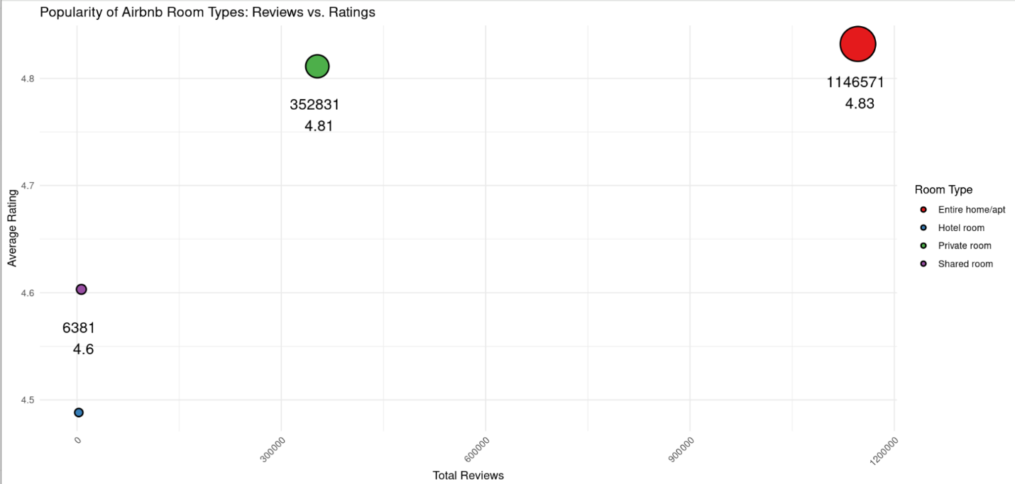
1. Popularity of Airbnb Properties
Popularity Insights: The plot highlights the popularity of Airbnb room types based on total reviews and average ratings.
Top Performers: Entire homes/apartments dominate with 1,146,571 reviews and an excellent average rating (4.83), followed by private rooms with 352,831 reviews and a strong average rating (4.81).
Key Takeaway: Entire homes/apartments and private rooms are nearly equally popular in terms of average ratings, though entire homes lead in review volume.

Slide 5

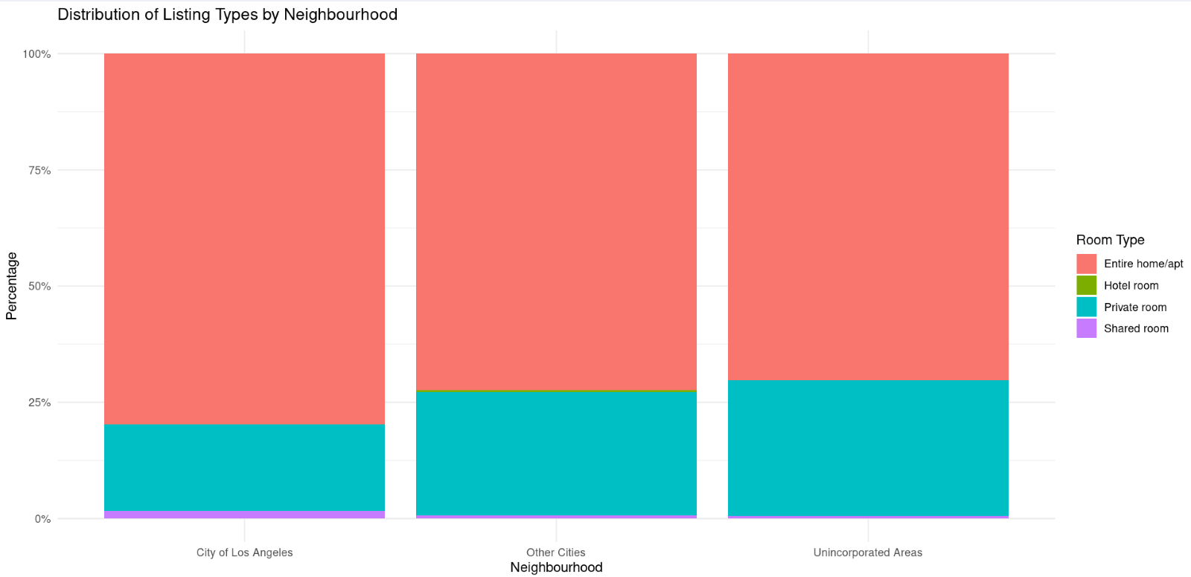

2. Distribution of Listing types by Neighborhood
Regional Distribution of Airbnb Listing Types
Each bar represents a region, showing the proportion of listing types (entire home, private room, shared room, hotel).
Percentages sum to 100% per region for easy comparison.
Key Insights on Listing Types
Entire home/apartment dominates across all regions (over 75% of listings).
Private room listings are the second most common (20-25% per region).
Rarity of Other Listing Types
Shared rooms and hotel rooms are scarce, making up less than 10% of listings in each region.

Slide 6
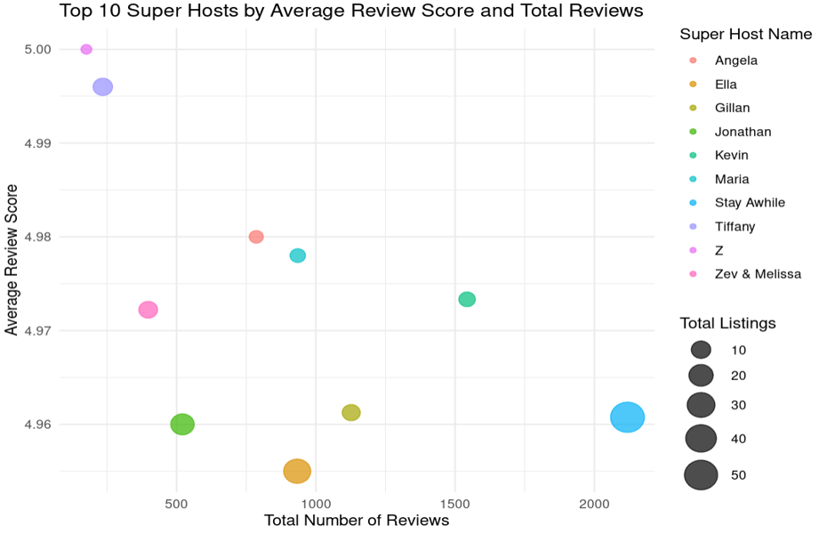
3. Super Hosts: Correlation Between Listings, Review, and Number of Reviews
Key Observations:
Top Super Hosts have exceptionally high review scores, ranging from 4.96 to 5.00, demonstrating strong guest satisfaction.
Hosts with more reviews and listings generally have slightly lower review scores, as managing more listings may present challenges in maintaining consistency, potentially affecting review scores.
Hosts with fewer listings generally have higher review scores because they can focus on providing personalized experiences, which often leads to higher ratings.

Slide 7
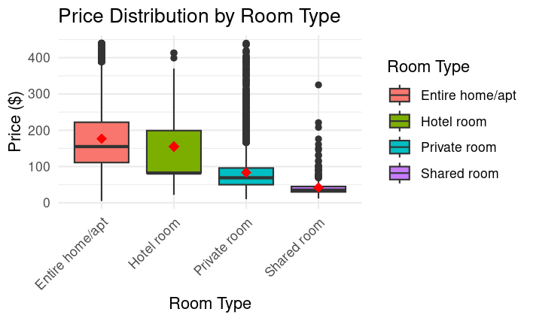
4. Price Distribution by Room Type
Key Observations:
Entire homes/apartments have the highest median price ($200) with outliers exceeding $400, ideal for families and luxury travelers.
Hotel rooms have a median price of $150, with a consistent price range, making them suitable for mid-range travelers.
Private rooms are more affordable, with a median price of $75, appealing to solo travelers or couples.
Shared rooms are the cheapest option, with a median price under $50, attracting budget-conscious guests.
Insight: Entire homes dominate the high-end market, while shared rooms cater to budget travelers.

Slide 8
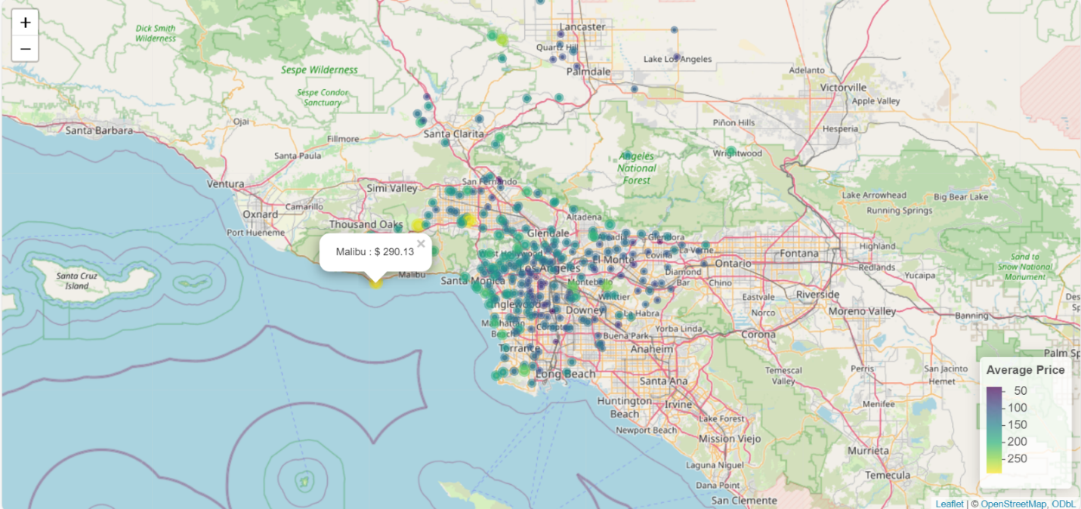
5. Airbnb Prices by LA Neighborhoods
Key Observations:
Coastal neighborhoods like Malibu, Santa Monica, and areas closer to national parks command premium prices due to scenic views and tourist demand.
Luxury areas like Hidden Hills, popular for celebrity residents, rank among the most expensive locations.
Inland neighborhoods, further from attractions, offer significantly lower average prices.

Slide 9
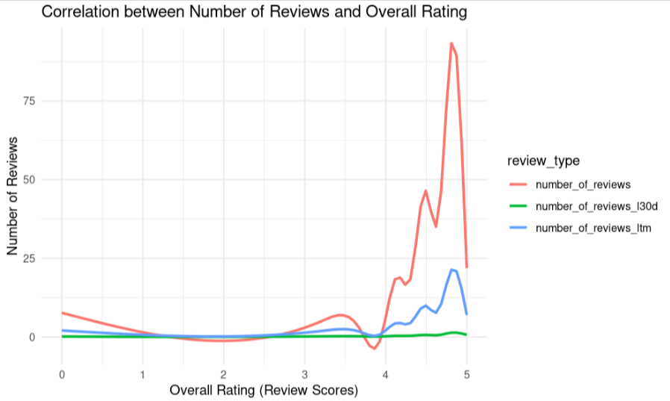
6. Correlation between the number of reviews and overall ratings
Key Observations:
A positive slope highlights that higher ratings are associated with more reviews within each timeframe, indicating that well-rated hosts attract more guest feedback.
Slopes for the last 12 months and overall periods show fewer recent reviews, as indicated by the flatter slope for the last 30 days.
Strong positive trends across all timeframes show that higher-rated hosts consistently receive more reviews, regardless of review timing.

Slide 10
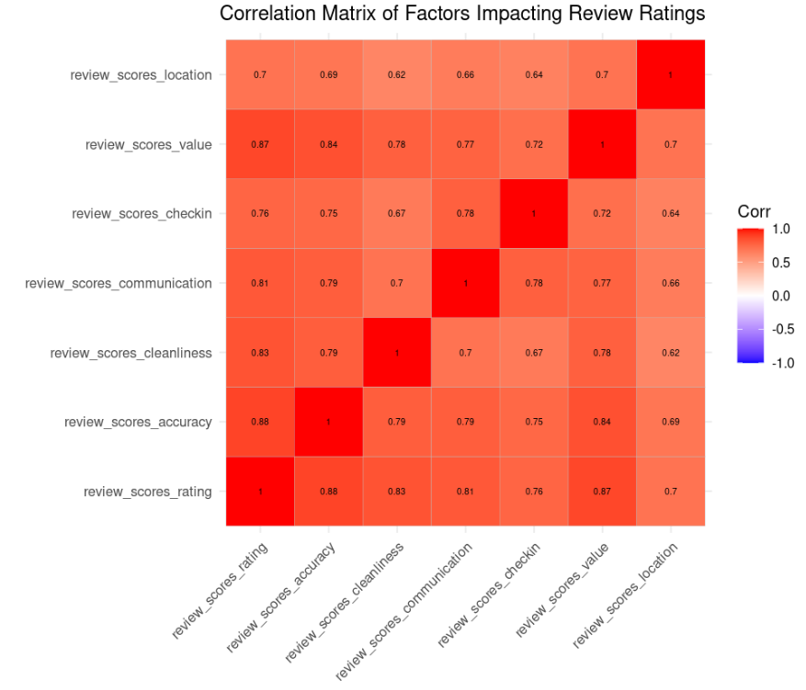
7. Factors impacting the review ratings
Key Observations:
In the corrplot, darker shading points to stronger correlations, clearly identifying accuracy and value as the primary factors influencing review_scores_rating
High correlations between review_scores_rating and factors like review_scores_accuracy and review_scores_value indicate these are the most critical drivers of guest satisfaction.
The location and checkin has the least impact on the overall rating indicating that other factors like cleanliness, proper communication is more important for the customers.

Slide 11
Overview of Airbnb Price Prediction Modeling
Objective: Predict Airbnb listing prices using data-driven insights to optimize pricing strategies.
Features Used:
Categorical: Room type, host status, location, neighborhood group instant bookable.
Numerical: Accommodates, beds, minimum nights, price.
Interaction Features: Accommodates_beds.
Workflow: Preprocessing included one-hot encoding, normalization, and feature engineering, followed by model training, testing, evaluation, and tuning.
Models developed: Linear Regression, Decision Tree, and Random Forest.

Slide 12
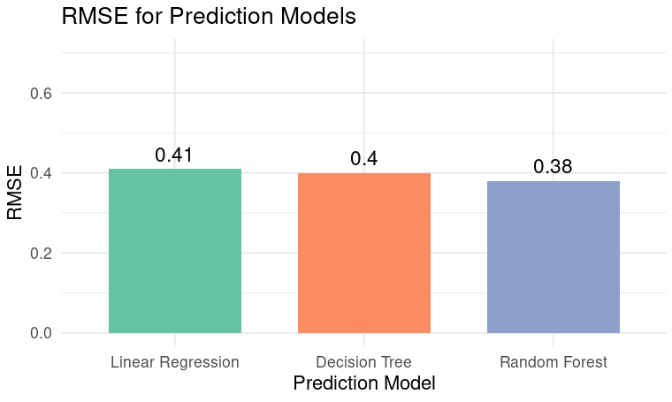
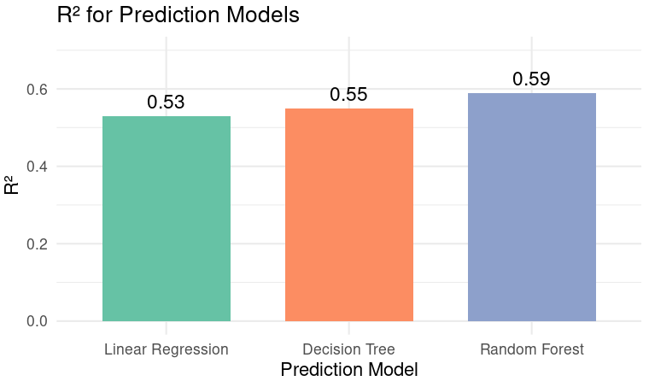
Comparison of Model Performance
The Random Forest model has the lowest RMSE of 0.38 compared to the other models.
The Random Forest model has the highest R2 of 0.59 compared to the other models.
Best Fit Model: Random Forest

Slide 13
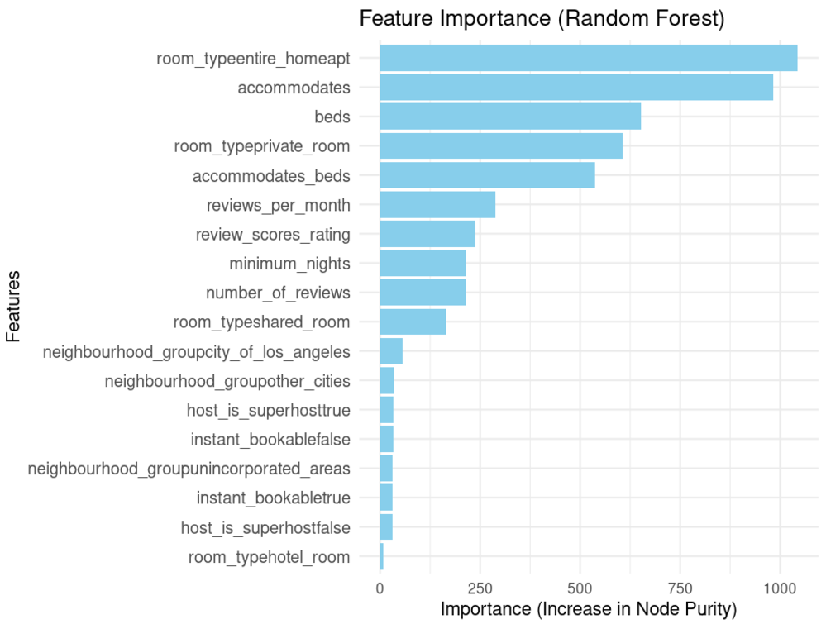
Feature Importance of Best Model (RF)
room_typeentire_homeapt feature is the most important feature, indicating that whether the room type is an entire home/apartment has the highest impact on predicting price.
Features related to size, such as accommodates and beds follow as significant contributors, likely because they directly relate to the capacity and suitability of the listing for guests.

Slide 14
Main challenges
identified
01.
02.
03.
Dataset
High Prevalence of Null values in host_response_rate and host_acceptance_rate hindered analysis of key host metrics.
Missing booking dates impacted the accuracy of predictive price modeling. (Seasonal trend)
Data Modelling
Identifying the right scaling or standardization technique for numeric variables and labels to avoid introducing bias into the model.
Creating the correct interaction features that enhance accuracy.
Environmental/Platform
We could not properly perform hyperparameter tuning due to R Studio's limited RAM.

Slide 15

Conclusions
Key Observations:
Entire homes dominate: These are the most popular and profitable listing types.
Price and location matter: Coastal areas and luxury neighborhoods command premium prices.
Super Hosts excel: They maintain high ratings and attract more guests.
Reviews drive success: Positive reviews lead to more bookings and higher income.
Best Model:
The Random Forest price prediction models outperform others with the lowest RMSE (0.38) and highest R² (0.59).
Future Improvements:
Improve missing data imputation, add interaction and seasonal features, optimize hyperparameters, and test advanced models like GBT and XGBoost to boost prediction accuracy.

Slide 16


Questions
Thank you very much!
https://github.com/ayushiporwal13/Airbnb-Price-Prediction

